Slide 1




Bilgisayar Mühendisliği Bölümü
GTU CSE 496
GRADUATION PROJECT -2-
TURKISH TEXT CORRECTOR PLUGIN
ÇAĞRI ÇAYCI
ADVISOR: Dr. GÖKHAN KAYA
MARCH 2024
GTÜ - Bilgisayar Mühendisliği Bölümü
BİL 495/496 Bitirme Projesi
GTU COMPUTER ENGINEERING DEPARTMENT
CSE 496 GRADUATION PROJECT 2
Notes:
2

Slide 2

Contents
Introduction
Design Plan
Requirements
Timeline
Success Criteria
Resources
GTU COMPUTER ENGINEERING DEPARTMENT
CSE 496 GRADUATION PROJECT 2
Notes:
2

Slide 3

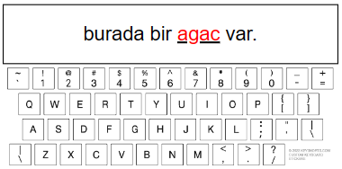
Introduction
Turkish Text Corrector Plugin is a browser extension intended to correct errors that arise when users type Turkish words using an English keyboard layout. This tool enhances typing precision and efficiency, particularly for those who frequently need to input Turkish text but are constrained by the keyboard layout.
GTU COMPUTER ENGINEERING DEPARTMENT
CSE 496 GRADUATION PROJECT 2
GTÜ - Bilgisayar Mühendisliği Bölümü
BİL 495/496 Bitirme Projesi

Slide 4
Design Plan
This project consists of 3 main steps:
Character Substitution: Substituting 'c' with 'ç', 'g' with 'ğ', 'i' with 'ı', etc.
Dictionary Lookup: Verifying words against a Turkish dictionary.
Proper Sentence Analysis: Composing the sentences using the most proper words and selecting most proper sentence.
GTU COMPUTER ENGINEERING DEPARTMENT
CSE 496 GRADUATION PROJECT 2
GTÜ - Bilgisayar Mühendisliği Bölümü
BİL 495/496 Bitirme Projesi

Slide 5
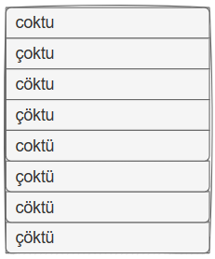
Design Plan
1. Character Substitution
Different forms of words are generated by substituting some letters with its Turkish equivalent. As a result of this process, 2 to the power of n words are generated, where n is the number of letters not found on the English keyboard in the word.
GTU COMPUTER ENGINEERING DEPARTMENT
CSE 496 GRADUATION PROJECT 2
GTÜ - Bilgisayar Mühendisliği Bölümü

Slide 6
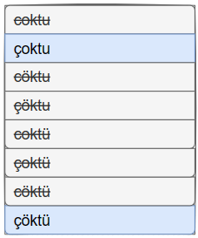
Design Plan
2. Dictionary Lookup
Having too many different forms of a word can make the next step difficult. Some of these words must be eliminated to increase efficiency. The best way to do this is to eliminate words that are not in the dictionary.
GTU COMPUTER ENGINEERING DEPARTMENT
CSE 496 GRADUATION PROJECT 2
GTÜ - Bilgisayar Mühendisliği Bölümü

Slide 7
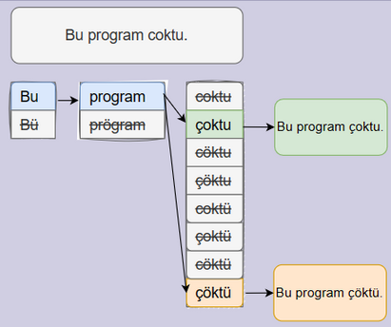
Design Plan
3. Proper Sentence Analysis
Following the elimination phase, the creation of sentences necessitates the combination of various word forms. When multiple sentences are possible, the selection of the word form must be determined based on the context. A Deep Learning Model must be examine the sentences and select the most proper one.
GTU COMPUTER ENGINEERING DEPARTMENT
CSE 496 GRADUATION PROJECT 2
GTÜ - Bilgisayar Mühendisliği Bölümü
BİL 495/496 Bitirme Projesi

Slide 8
Requirements
To complete this project, some of the requirements are;
A web extension must be created that can read and modify text within text areas.
A Deep Learning Model must be developed and trained with Turkish sentences to select proper sentence.
The plugin must be tested with trivial (“bugun”) and non-trivial (“cig”) cases.
GTU COMPUTER ENGINEERING DEPARTMENT
CSE 496 GRADUATION PROJECT 2
GTÜ - Bilgisayar Mühendisliği Bölümü
BİL 495/496 Bitirme Projesi

Slide 9
Requirements
To satisfy the requirements, the following steps will be
applied;
Web extension will be developed in JavaScript.
Extensive vocabulary for Turkish dictionary will be collected.
Dataset of sentence will be gathered to train deep learning model.
A Deep Learning Model will be developed in Python.
GTU COMPUTER ENGINEERING DEPARTMENT
CSE 496 GRADUATION PROJECT 2
GTÜ - Bilgisayar Mühendisliği Bölümü
BİL 495/496 Bitirme Projesi

Slide 10
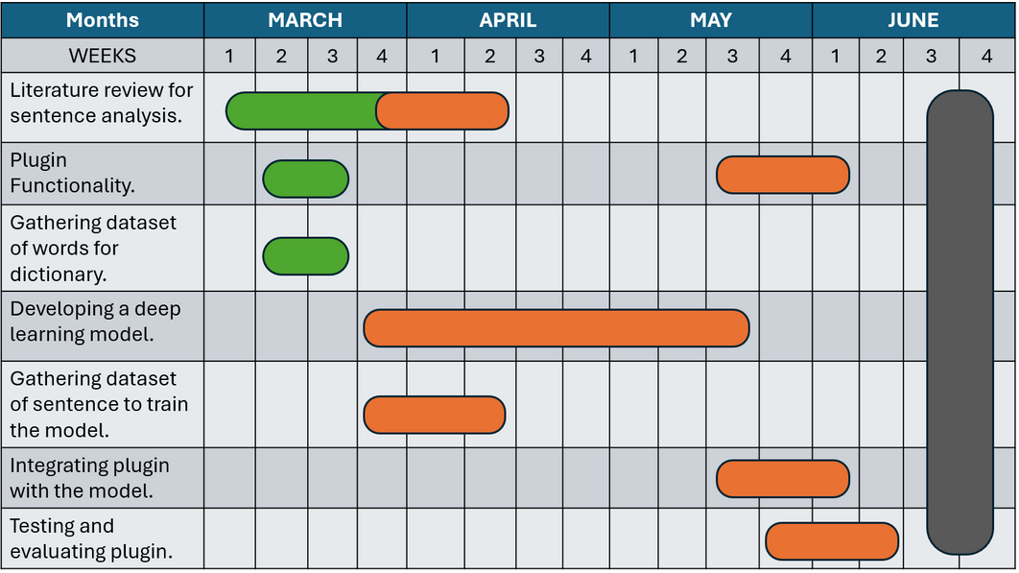
Timeline
GTU COMPUTER ENGINEERING DEPARTMENT
CSE 496 GRADUATION PROJECT 2
GTÜ - Bilgisayar Mühendisliği Bölümü

Slide 11
Success Criteria
Success criteria for the Turkish Text Corrector Plugin are;
Trivial Words Correction: Achieve a success rate of 90% or higher for correcting trivial words.
Non-Trivial Words Correction: Achieve a success rate of 60% or higher for correcting non-trivial words.
Timeliness: Find the incorrect words and make the necessary corrections within 3 seconds after the completion of the sentence.
GTU COMPUTER ENGINEERING DEPARTMENT
CSE 496 GRADUATION PROJECT 2
GTÜ - Bilgisayar Mühendisliği Bölümü
BİL 495/496 Bitirme Projesi

Slide 12
Resources
https://www.aarp.org/home-family/personal-technology/info-2022/web-browser-extensions.html [Browser Extension Image]
http://www.nyiniyu.com/?en_text-correction-and-translation,46 [Text Correction Image]
https://www.drawio.com/ [Design Plan Images]
GTU COMPUTER ENGINEERING DEPARTMENT
CSE 496 GRADUATION PROJECT 2
GTÜ - Bilgisayar Mühendisliği Bölümü
BİL 495/496 Bitirme Projesi

Slide 13
THANK YOU FOR LISTENING
GTU COMPUTER ENGINEERING DEPARTMENT
CSE 496 GRADUATION PROJECT 2
GTÜ - Bilgisayar Mühendisliği Bölümü
BİL 495/496 Bitirme Projesi

